Slide 1
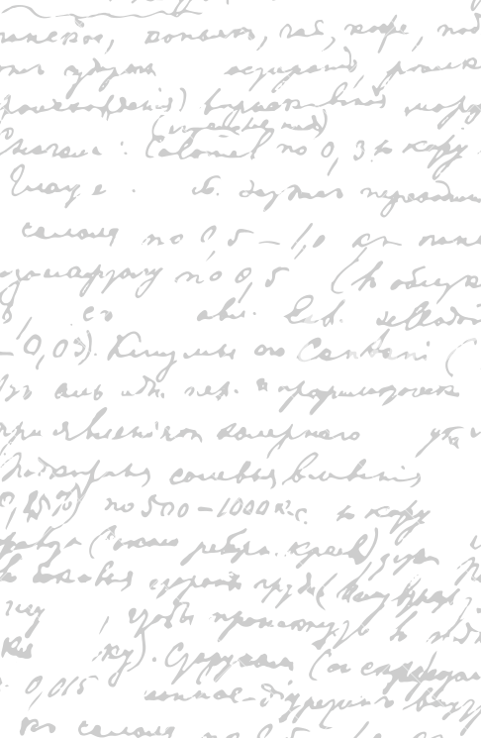



Andrew Wu 2133861w
Waiter App
HI, there!
Project Launch Meeting 8 October 2020

Slide 2
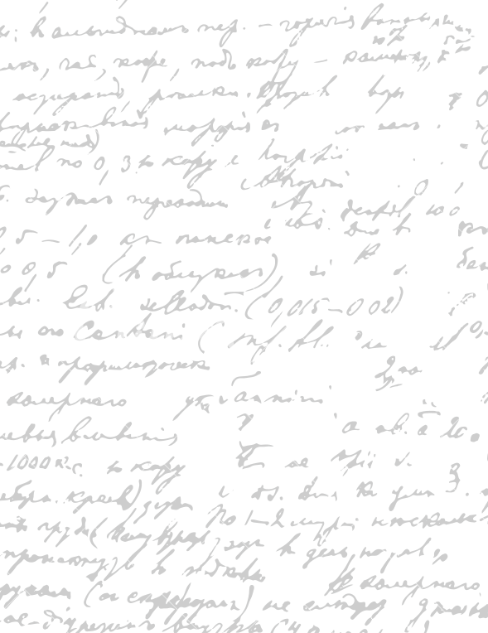



Start Recording

Slide 3
Main Topics
1. One Year Plan
2. GDPR
3. Non-Disclosure Agreement
4. Intelligential Property
5. Project Development Platform

Slide 4
Main Topics
6. Product Paper Prototype
7. Product Digital Prototype

Slide 5

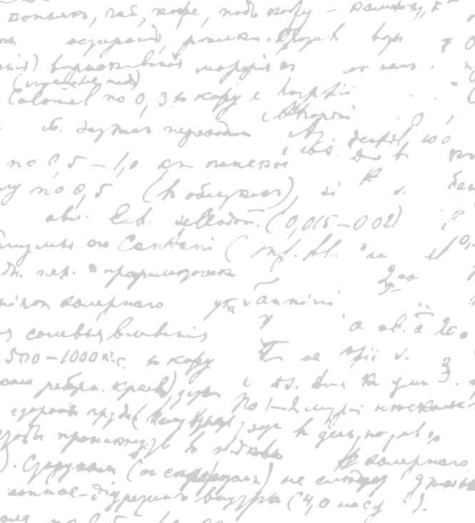

We have already gone through the general specifications of the project
We will refine it as we go and present it again in the second semester because the product specification may be different later as the project evolves
We will go through the headings quickly
One Year Plan

Slide 6
Project Specification
Brief Project Outline
Project Objectives and Market Competitiveness
Detailed Project Conceptual Analysis
Software Marketing
Annual Revenue Estimation
Product Pricing
Product Launch Strategy
One Year Plan
(Done)

Slide 7
Project Specification
GDPR
Non-Disclosure Agreement
Intelligential Property
User Stories
Product Paper Prototype
Product Digital Prototype
Project Development Platform
Product Coding
Product Evaluation
Product Testing
Product Deployment Platform
One Year Plan
(Not Done)

Slide 8
Our project will need to comply with GDPR because we are storing data from our users (name, card details…)
We may want to go through GDPR in the second semester because it is being covered in the Professional Skills and Issue Course in the first semester.
GDPR

Slide 9
We may not want to disclose the project through the public presentation in March. Should we ask for an NDA? If we can’t finish the product in 4th year, we can still use my 5th year to continue with the project and not disclosing the project at all?
Will I be able to do this product as my 5th year individual project?
How should I upload my project because the lecture notes said that NDA project are uploaded using an encrypted version tracked USB stick. It also said that the passwords must be sent separately to the markers.
Non-Disclosure Agreement

Slide 10
Intelligential Property
Apart from you and myself who will own the IP, would the University own the IP as well since they are providing me with the course resource to do it.

Slide 11
Version Control/ Issue Tracker
External Backup
Minutes/ Plans
Project Development Platform

Slide 12
Version Control/ Issue Tracker
we will use GitLab
Free
Used before
Adequate for the job
Should spend more time focus on developing the product than deciding on the platform
Do I need to include my platform consideration in the dissertation? Or it is too obvious?
Project Development Platform

Slide 13
External Backup
How do we do external backup? Do we open another GitLab account and have two copies?
Project Development Platform

Slide 14
Minutes/ Plans
I can’t find meeting minutes software that are for free.
Should I just upload the minutes to the GitLab’s wiki? What is your recommendation?
Project Development Platform

Slide 15
Should we follow a book/ research paper to learn the best design practice or should we just make some designs from scratch?
What design pattern books would you recommend me to read and follow?
What are the design platform you would recommend? Balsamiq? Lucidchart?
Project Paper Prototype

Slide 16
What platform should I choose for the digital interaction prototype?
AdobeXD? I used that before.
Project Digital Prototype

Slide 17
Set Up Project Development Platform
Version control/ Issue tracker
External Backup
Plans/ Minutes
User Stories
Product Paper Prototype
Product Digital Prototype
Next Step!

Slide 18
End

